Slide 1
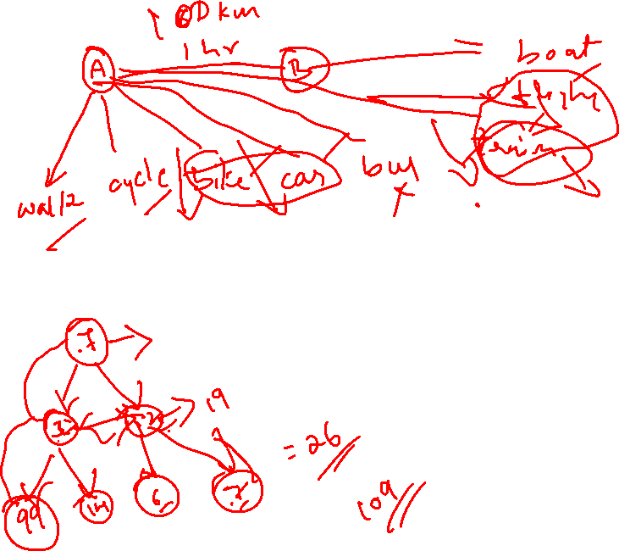
Greedy Technique

Slide 2
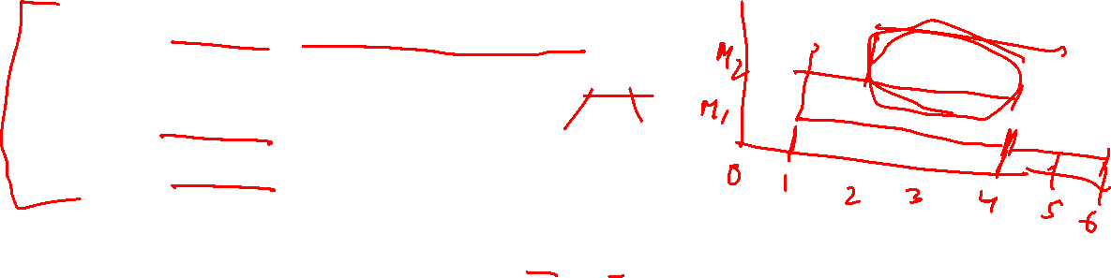
Machine Scheduling
Given: n tasks, infinite supply of machines
Each task has processing interval [si, fi]
Si -> Start time
Fi -> Finish time
Overlapping tasks: Two tasks i & j overlap if and only if their processing intervals overlap other than start or finish time
[1,4] does not overlap [4,6]
[1,4] overlaps [2,6]

Slide 3
Feasible Solution : Task to machine assignment in which no machine is assigned two overlapping tasks
Each machine works on one task at a time
Optimal Assignment : Feasible assignment that utilizes fewest number of machines
Greedy criterion : If an old machine becomes available by the start time of the task to be assigned, assign the task to this machine; if not assign it to a new machine.

Slide 4
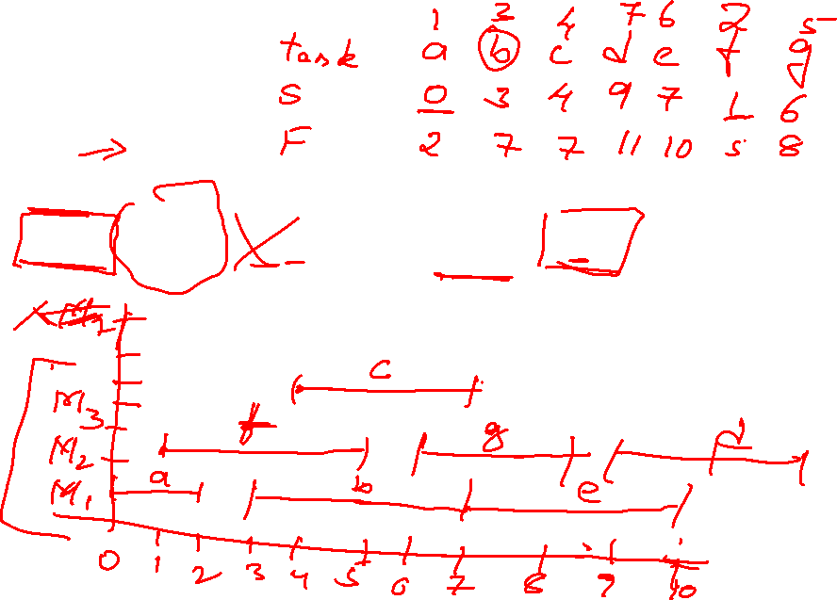
Example
n=7
a[0,2] b[3,7] c[4,7] d[9,11] e[7,10] f[1,5] g[6,8]

Slide 5
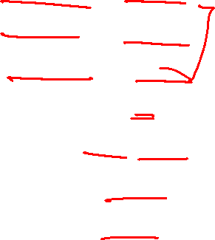
a[0,2] f[1,5] b[3,7] c[4,7] g[6,8] e[7,10] d[9,11]
Machine 1 – a[0,2]
Machine 2 – f[1,5]
Machine 1 – b[3,7]
Machine 3 – c[4,7]
Machine 2 – g[6,8]
Machine 1 - e[7,10]
Machine 2 – d[9,11]

Slide 6
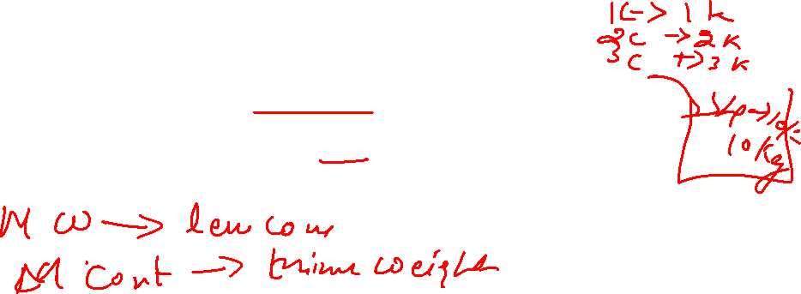
Container Loading Problem
A large ship is to be loaded with cargo. The cargo is containerized, and all containers are the same size.
Different containers may have different weights.
Let w_{i} be the weight of the i^{th} container, 1≤ i ≤ n.
The cargo capacity of the ship is c.
Load the ship with the maximum no of containers.

Slide 7
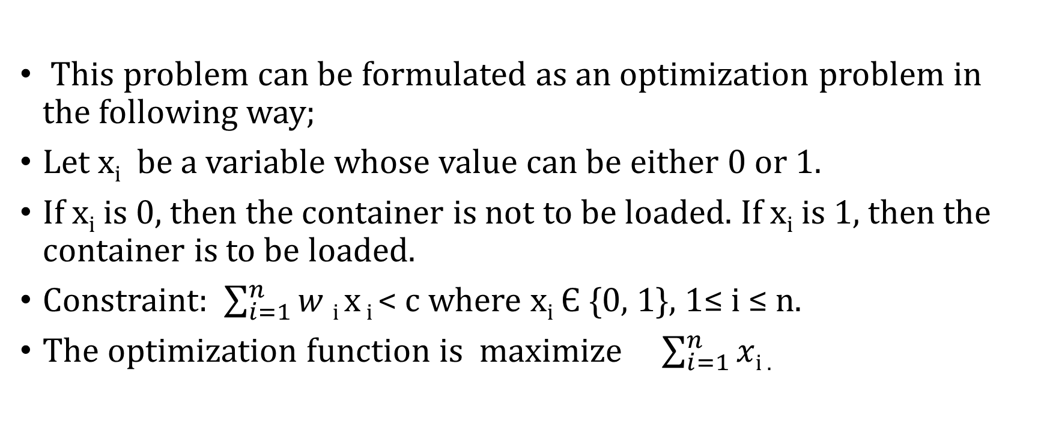
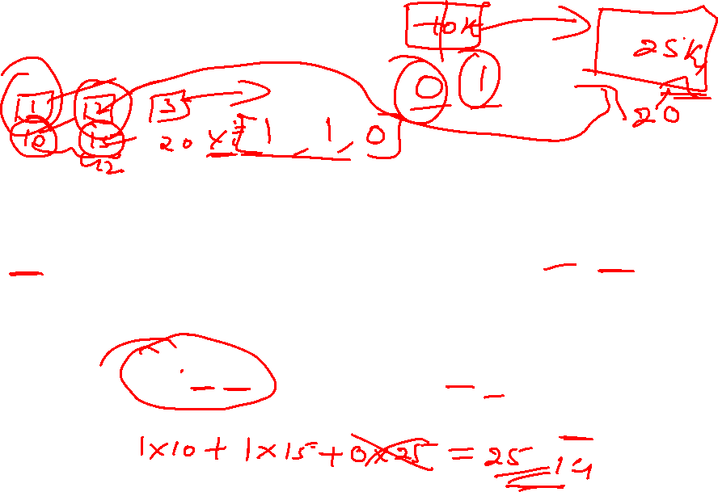
Container Loading
This problem can be formulated as an optimization problem in the following way;
Let x_{i} be a variable whose value can be either 0 or 1.
If x_{i} is 0, then the container is not to be loaded. If x_{i} is 1, then the container is to be loaded.
Constraint: $\sum_{i=1}^{n}{w }$_{i} x _{i} < c where x_{i} Є {0, 1}, 1≤ i ≤ n.
The optimization function is maximize $\sum_{i=1}^{n}{x}$_{i .}

Slide 8
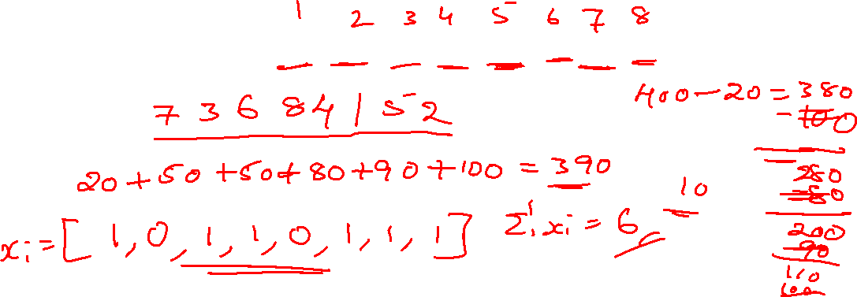
Container Loading
Greedy criterion: From the remaining containers, select the one with least weight.
Ex: n = 8,
[w₁, w₂ . . . . . . .w₈ ] = [ 100, 200, 50, 90, 150, 50, 20, 80,] and c = 400.

Slide 9
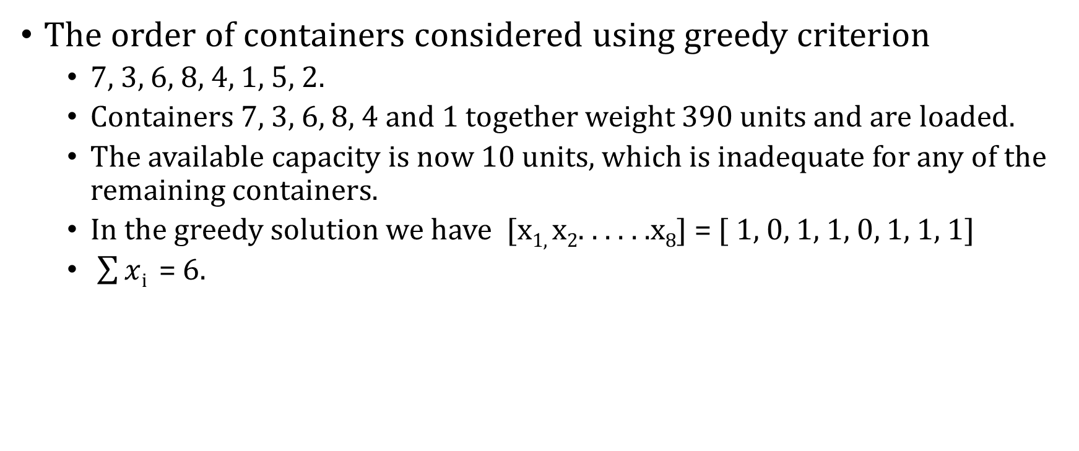
Container loading
The order of containers considered using greedy criterion
7, 3, 6, 8, 4, 1, 5, 2.
Containers 7, 3, 6, 8, 4 and 1 together weight 390 units and are loaded.
The available capacity is now 10 units, which is inadequate for any of the remaining containers.
In the greedy solution we have [x_{1,} x₂. . . . . .x₈] = [ 1, 0, 1, 1, 0, 1, 1, 1]
$\sum{x}$_{i} = 6.

Slide 10
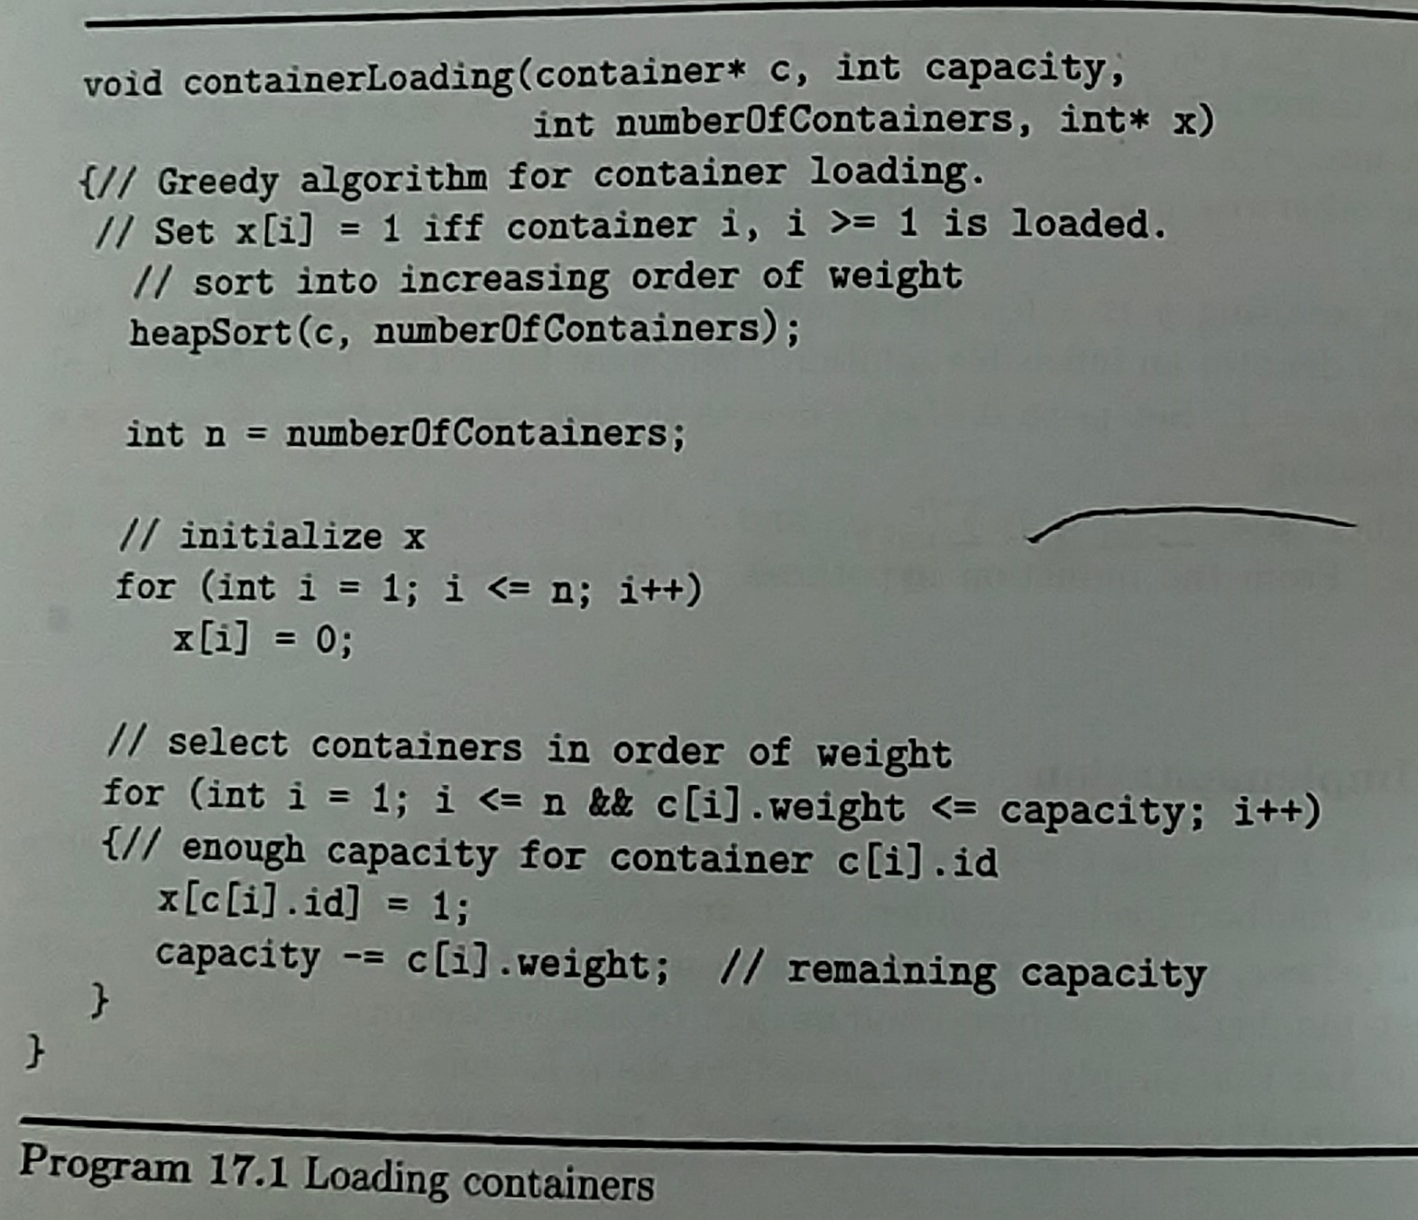
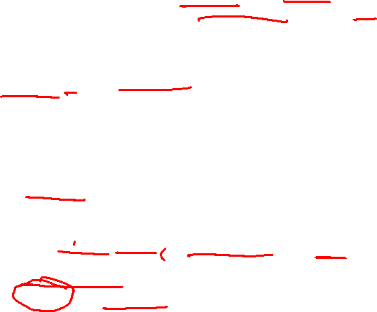

Slide 11
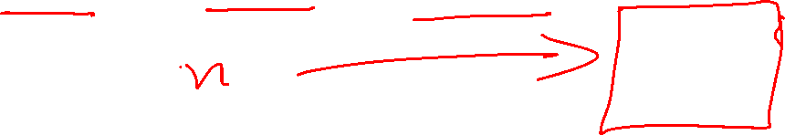
0/1 Knapsack Problem
In the 0/1 knapsack problem we wish to pack a knapsack (bag or sack) with a capacity of c.
From a list of n items, we must select the items that are to be packed into the knapsack.
Each object i has a weight w_{i} and a profit P_{i}

Slide 12
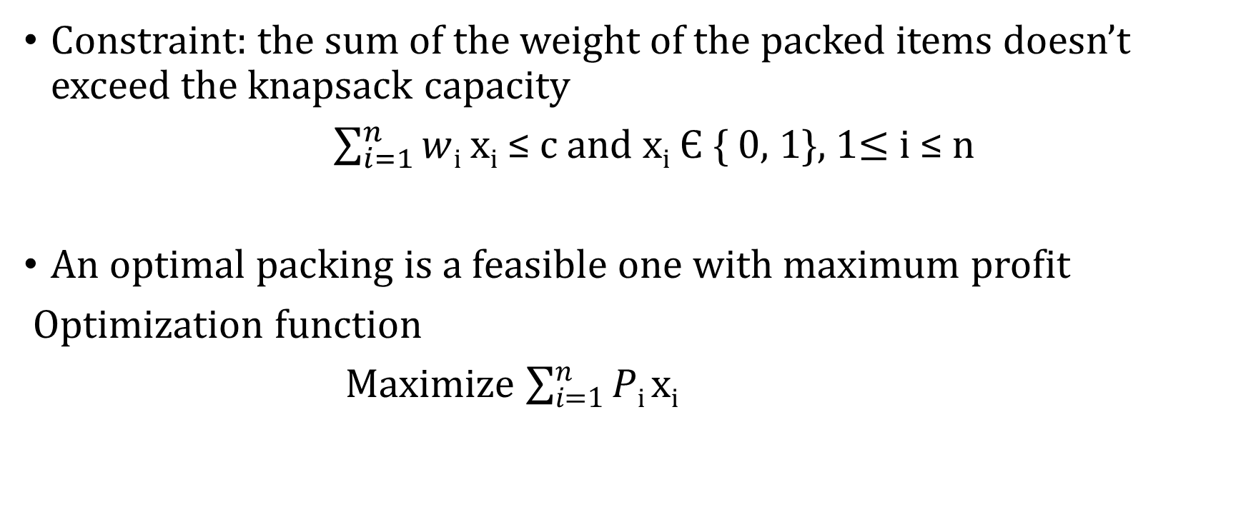
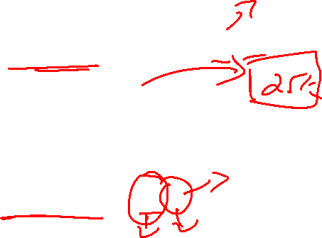
0/1 Knapsack problem
Constraint: the sum of the weight of the packed items doesn’t exceed the knapsack capacity
$\sum_{i=1}^{n}{w}$_{i} x_{i} ≤ c and x_{i} Є { 0, 1}, 1$≤$i ≤ n
An optimal packing is a feasible one with maximum profit
Optimization function
Maximize $\sum_{i=1}^{n}{P}$_{i} x_{i}

Slide 13
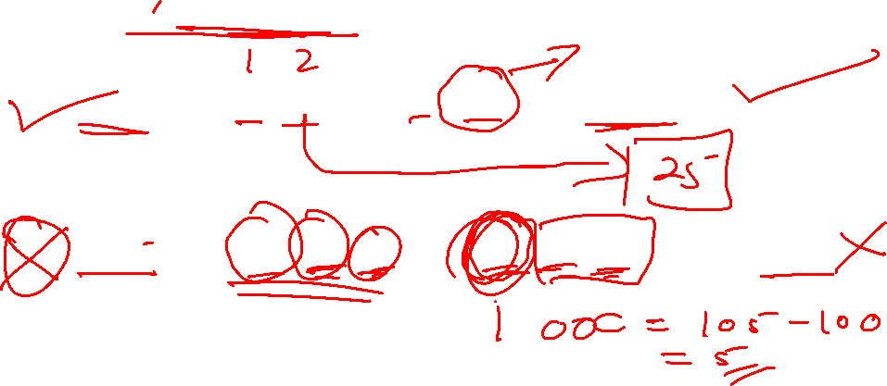
Method 1: Greedy on profit
Greedy criterion : From the remaining objects, select the object with maximum profit that fits into the knapsack.
Ex:
1 ) n =2, w= [10, 20], p = [5, 100] and c = 25.
2) n =3, w = [100, 10, 10], P = [20, 15, 15] and c = 105.

Slide 14
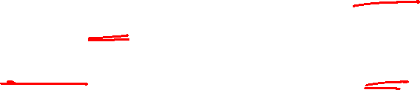
Greedy on profit
With greedy on profit criterion, we obtain the solution x =[1, 0, 0]
The total profit from this solution is 20
But the optimal solution is [0, 1, 1]. This solution has profit 30.

Slide 15
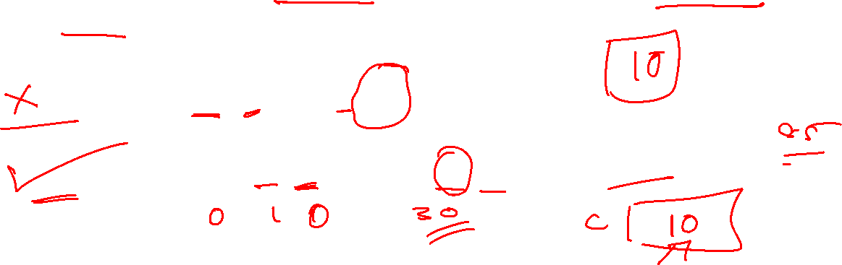
Method 2 : Greedy on weight
From the remaining objects, select the one that has minimum weight and also fits into the knapsack.
Ex:
1 ) n =2, w= [10, 20], p = [5, 100] and c = 25.
2) n =3, w = [100, 10, 10], P = [20, 15, 15] and c = 105.

Slide 16
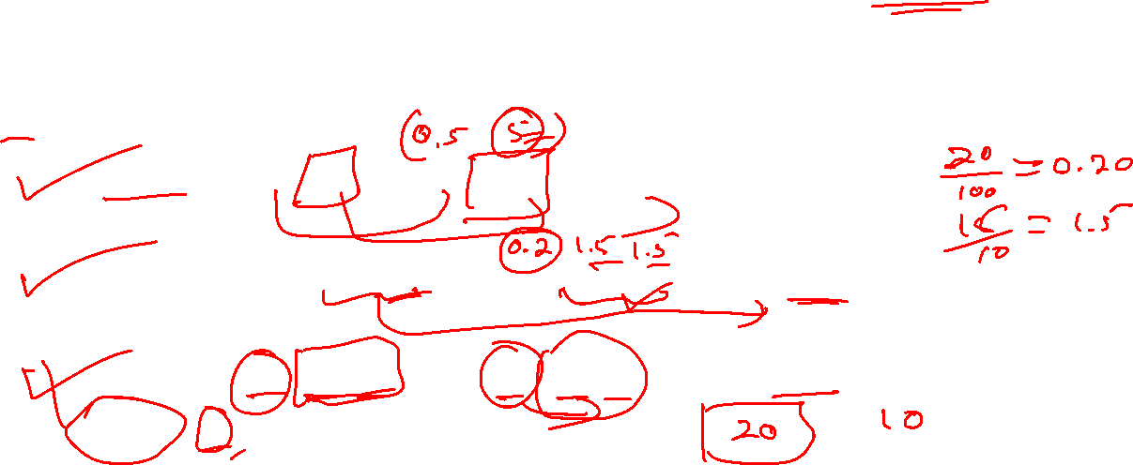
Method 3: Greedy on profit density : p_{i} / w_{i}
Criteria :
From the remaining objects, select the one with maximum p_{i /} w_{i} that fits into the knapsack.
1 ) n =2, w= [10, 20], p = [5, 100] and c = 25.
2) n =3, w = [100, 10, 10], P = [20, 15, 15] and c = 105.
3) n =3, w = [20, 15, 15], P = [ 40, 25,25] and c = 30.
[pi/wi]=[2 1.6 1.6]

Slide 17
Knapsack is NP hard problem
We can find polynomial time algorithm that solves it
Optimization problems that are NP-hard are often solved by approximation algorithm.
These do not guarantee optimal solution always; they guarantee closer solution to optimal.
Criterion 3 is a good heuristics and produces solutions that are very close to the optimal most of the time

Slide 18
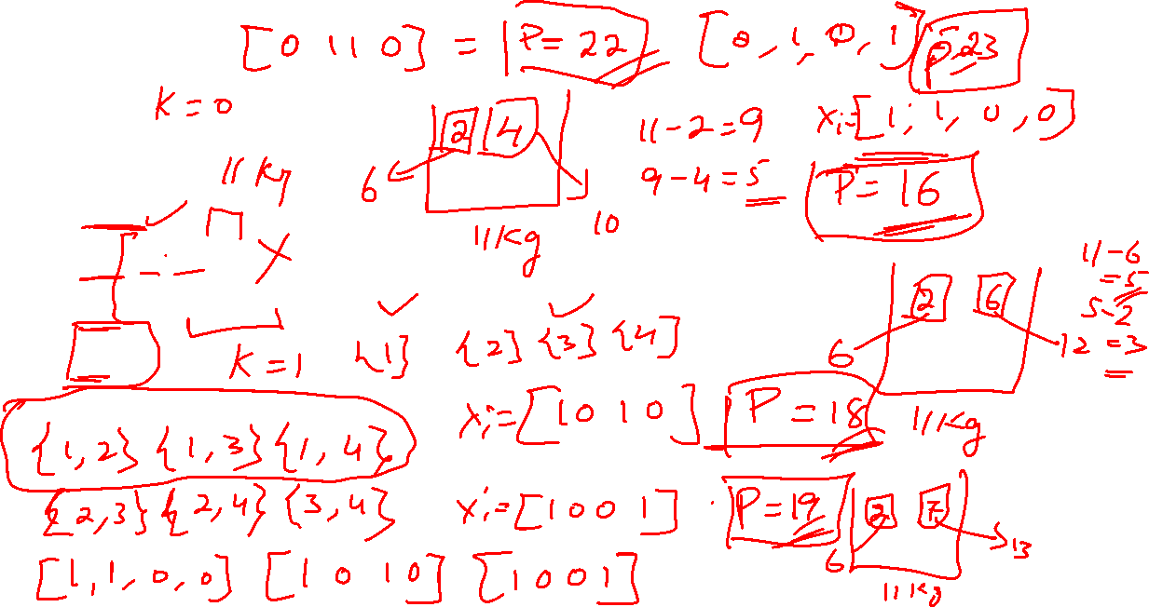
N=4
W=[2,4,6,7]
P=[6,10,12,13]
C=11

Slide 19
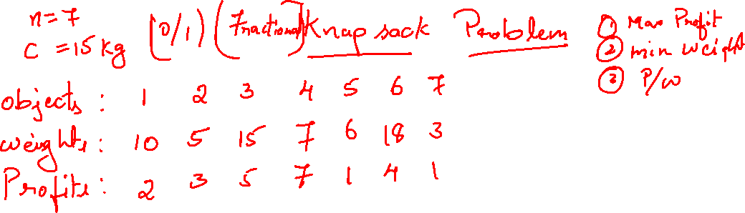
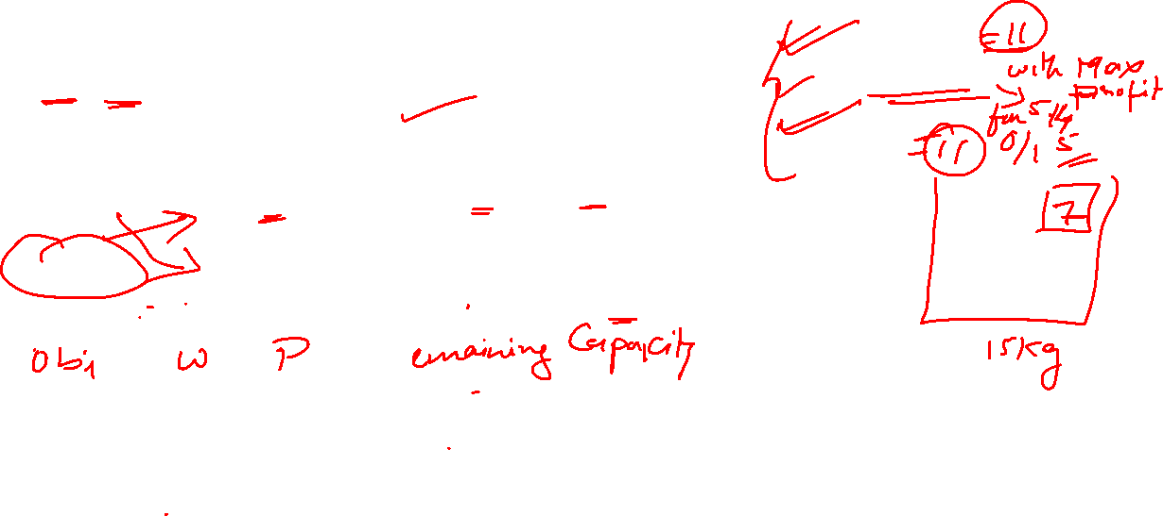

Slide 20
Topological Sorting
Complex project can be decomposed into many simpler tasks with the property that completion of all these tasks implies completion of the project.
Where certain tasks have to be performed or completed before carrying out other tasks
There will be a precedence relation between tasks
The set of tasks and precedence can be represented by a digraph called Activity on vertex (AOV) network

Slide 21
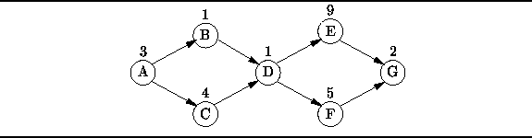
Activity on vertex (AOV) network
The vertices in this graph represent tasks.
The directed edge <i,j> indicates that the task i must complete before j starts

Slide 22
In order to complete the project the tasks must be carried out in a sequence having property that “ for every edge <i,j> in a digraph for project assembly, task i comes before j” in the assembly sequence.
The sequence that satisfies this property is called topological order or sequence.
The process of constructing topological order from a given AOV network is called topological sorting.
ABCDEFG
ACBDFEG
ABDCFEG

Slide 23
Greedy algorithm to construct topological order
Construct sequence from left to right in stages
In each stage add a vertex to a sequence
Greedy criterion:
From the remaining vertices select a vertex w such that it has no incoming edge <v,w> with the property that v has not already been placed into the sequence.

Slide 24
Pseudocode for topological sorting using Greedy algorithm
Let n be the number of vertices in the digraph .
Let V be an empty sequence,
while (true) {
Let w be any vertex that has incoming edge (v, w) such that v is in V.
If there is no such w, break.
Add w to the end of V
}
if ( V has fewer than n vertices )then algorithm fails.
else V is a topological sequence.
When algorithm fails it has no topological sequence or graph has cycle
Complexity : Ө(n²)
Ө(n+e)

Slide 25
int i=0;
while(!S.isEmpty())
{
int w;
w=s.pop();
v[i++]=w;
int u = Begin(w);
while(u)
{ Indegree[u]--;
If(!indegree[u]) S.push[u];
U=nextvertex(w);
}
}
DeactivatePos();
delete [] indegree;
return(i==n);
}
bool Topological(int v[ ])
{
int n = vertices();
int * indegree = new int[n+1];
InitializePos();
for(int i=1;i<=n;i++)
indegree[i]=0;
for(int i=1;i<=n;i++)
{ int u=Begin(i);
while(u)
{ indegree[u]++;
u=nextvertex[i];
}
}
Stack S;
for(int i=1;i<=n;i++)
if(!indegree[i])
S.push(i);

Slide 26
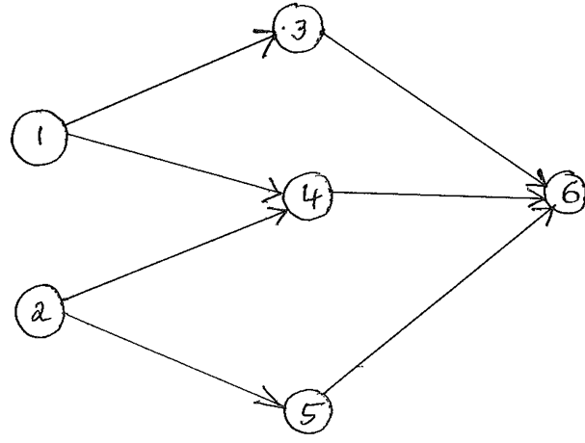

Slide 27
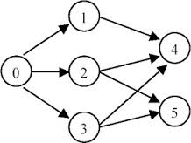

Slide 28
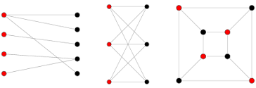
Bipartite Cover Problem
An undirected graph G is said to be Bipartite graph if its vertices can be partitioned in to sets A and B such that no edge in the graph connects two vertices in the same set.
A subset of A, A’ is said to cover the set B iff every vertex in B is connected to at least one vertex of A’
A’ is said to be minimum cover iff A has no subset of smaller size that covers B
The problem of finding minimum cover in a Bipartite graph is Bipartite cover problem

Slide 29
Bipartite Cover Problem
Greedy criterion : Select a vertex of A that covers largest number of (elements) uncovered vertices of B and add that vertex to A’ at each stage.
A’ = Ø
While(more vertices can be covered)
Add the vertex that covers the largest number of uncovered vertices to A’
if(some vertices are uncovered)
Algorithm fails
Else
A cover A’ has been found

Slide 30
Implementation
Bipartite cover : C
Number of elements in C : n
New_{i} : Number of uncovered vertices of B that i covers
In each stage select i from A with max New_{i} and then update New_{j} of other vertices which cover the vertices covered by i

Slide 31
Bool Bipartite()
{
m= 0
New[i]=degree[i] for all i in A
cov[i] = false for all i in B
While(New[i]>0 for some I in A)
{
Let V be a vertex with largest New[i];
C[m++]=V;
for(all vertices j adjacent from V)
{
if(!Cov[j])
{
Cov[j]=true;
Reduce new[k] by 1 for all vertices adjacent from j;
}
}
}
if(some vertices are uncovered)
return false
else
C is the cover
}

Slide 32
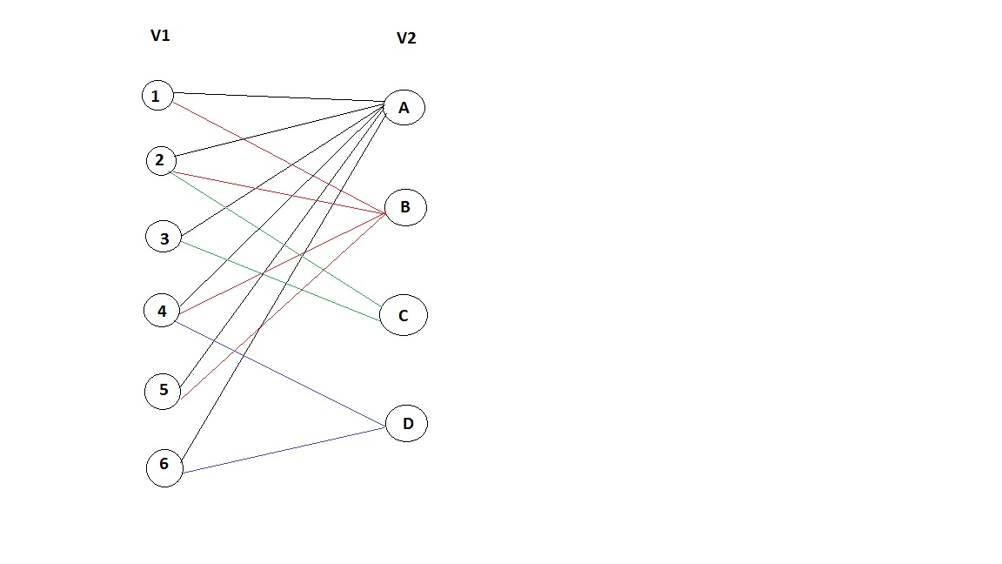

Slide 33
Finding shortest path form a source node to all other nodes in a network. (Dijkstra’s Algorithm)
Given : Directed graph G with the property that edge <i,j> has non negative cost
Find a shortest path from a given source vertex s to each of vertices in the graph to which there is a path from s.
Greedy criterion :
From the vertices to which shortest path has not been generated, select the one that results in least cost, that is in each stage shortest path to a new destination vertex is generated.

Slide 34
Dijkstra’s Algorithm
d[i] represents distance from s to i
p[i] represents preceding vertex of i in the path from s to i
Initialize d[i]=a[s][i], 1≤i≤n
Set p[i] = s for all i adjacent from s otherwise p[i]=0;
Create a list L of all vertices for which p[i]≠0
2. If L is empty terminate, Otherwise go to step 3
Delete from L the vertex i with least value of d (distance)
Update d[j] (j : 1 to n) to
d[j] = Min {d[j], d[i]+a[i][j]} for all unreached vertices j adjacent from i.
If d[j] changes then update p[j]=i & add j to L if it is not already present, go to step 2

Slide 35
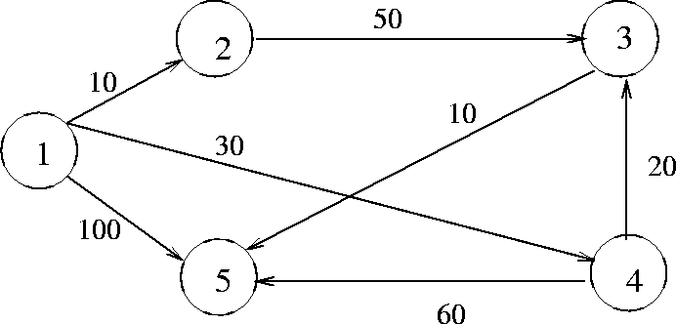
Iteration | i | D_{2,} P₂ | D_{3,} P₃ | D₄, P₄ | D₅, P₅ | L
Initial | {1} | 10, 1 | ∞,0 | 30,1 | 100,1 | [2,4,5]
1 | {2} | 10,1 | 60, 2 | 30,1 | 100,1 | [4,5,3]
2 | {4} | 10,1 | 50, 4 | 30,1 | 90,4 | [3,5]
3 | {3} | 10,1 | 50,4 | 30,1 | 60,3 | [5]
4 | {5} | 10,1 | 50,4 | 30,1 | 60,3 | [ ]

Slide 36
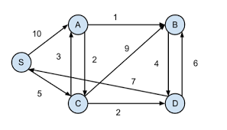
Find the shortest paths from S to all the other vertices using Dijstras algorithm

Slide 37
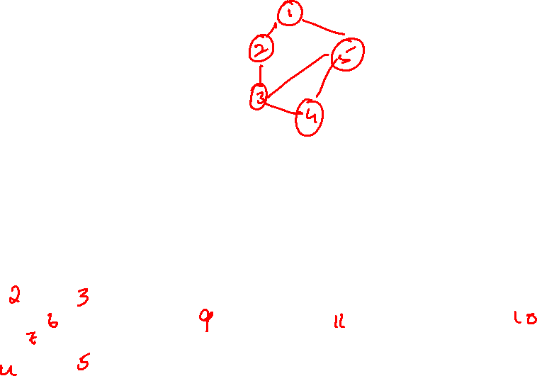
Spanning tree
Let G = ( V, E) be an undirected connected graph. A subgraph T = ( V, E ') of G is a spanning tree of G iff T is a tree.
0
0
0
0
1
2
1
2
1
2
1
2
3
3
3
3
G1
Possible spanning trees

Slide 38
Minimum cost spanning tree
Select n-1 edges from given n-vertex graph such that the selected edges form least cost spanning tree.
There are three different greedy strategies to select n-1 edges resulting in three different algorithms for Minimum cost spanning tree
Kruskal’s
Prims
Sollins

Slide 39
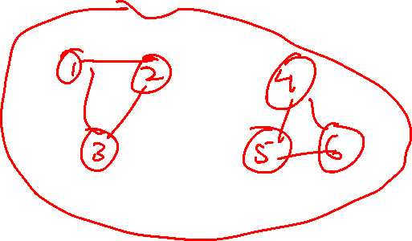
Kruskals algorithm
Greedy criterion: From the remaining edges, select a least cost edge that doesn’t result in a cycle when added to a set of already selected edges.
Algorithm
Let T be the set of selected edges.
Initialize T = Ø
Let E be the set of network edges.
while (E ≠ Ø) & & (|T| ≠ n-1)
{
Let (u, v) be a least cost edge in E.
E = E – {(u, v)}.
if ( (u, v) doesn’t create a cycle in T)
add edge (u, v) to T.
}
if (|T| = = n-1) T is a minimum –cost spanning else.
else the N/W is not connected and has no spanning tree.

Slide 40
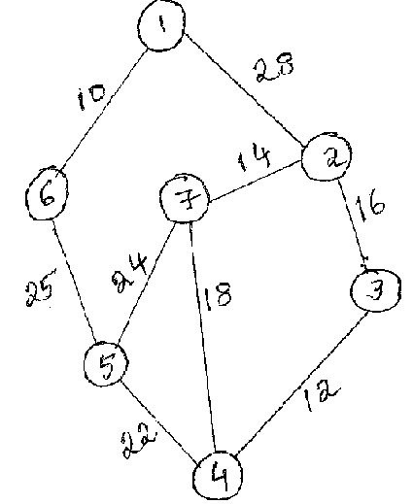
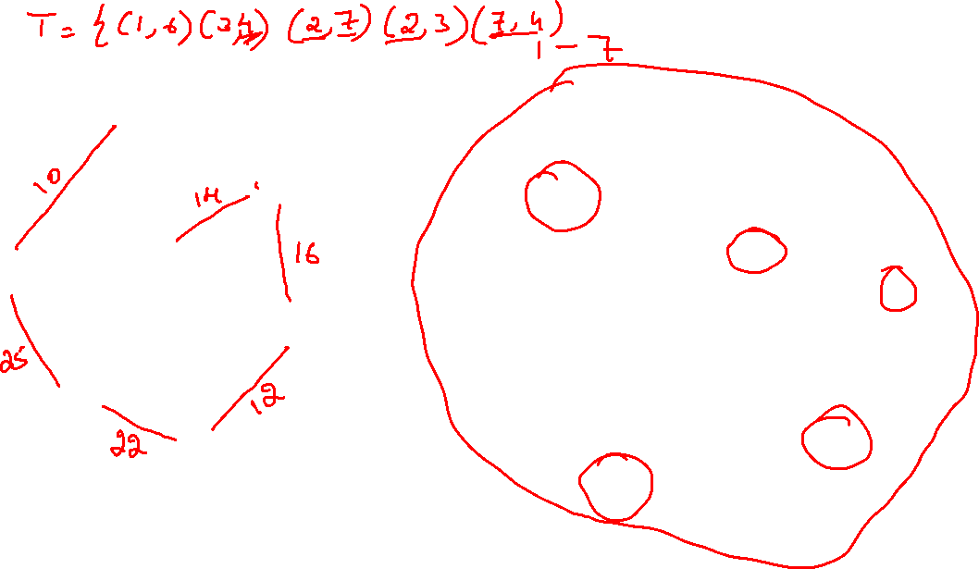
1
2
7
6
3
5
4

Slide 41
1
2
7
6
3
5
4

Slide 42
This can be implemented by sorting the edges – e log e
N-1 edges are added to array T by checking whether it would form cycle T has at the max n-1 edges –Ө(n)
Total complexity of Kruskals algorithm is Ө(n+e log e)

Slide 43
Prim’s Algorithms
Greedy Criterion : From the remaining edges, select a least – cost edge whose addition to the set of selected edges forms a tree.
Algorithm:
Let T be the set of selected edges. Initialize T = Ø.
Let TV be the set of vertices already in the tree.
Set TV = { 1 }
Let E be the set of network edges.
while ( E ≠ Ø ) & & ( |T| ≠ n – 1 ) {
Let (u, v) be a least – cost edge such that u Є TV and v doesn’t Є TV .
if (there is no such edge) break
E = E- { (u, v)}
Add edge (u, v) to T.
}
if ( |T| = = n – 1) T is a minimum cost spanning tree.
else the N/W is not connected and has no spanning tree.

Slide 45
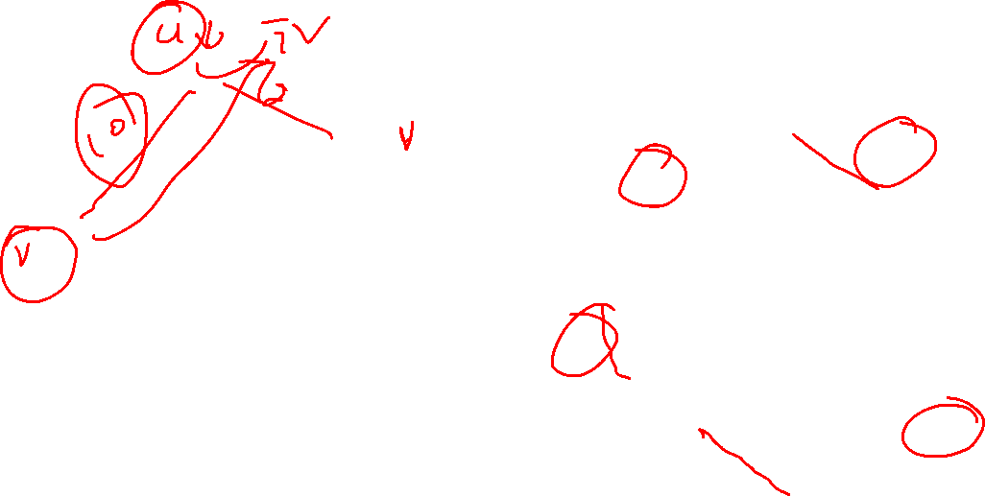
1
2
7
6
3
5
4

Slide 46
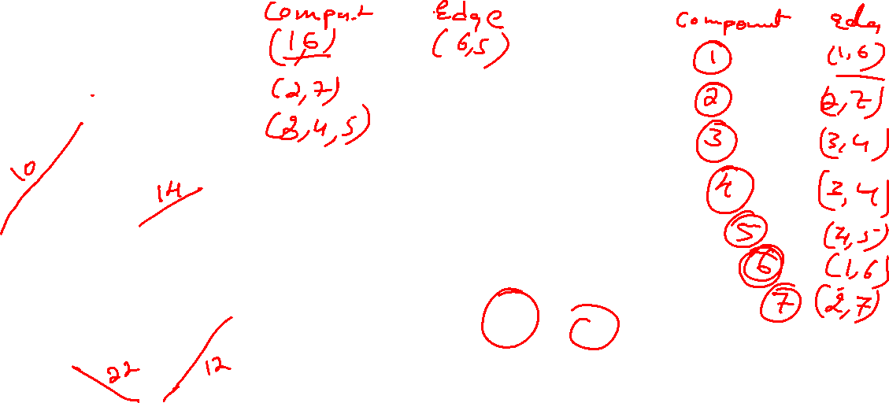
1
2
7
6
3
5
4

